Slide 1
Technology Transformation Project
Patrick Desbrow
Define Tollgate Review

Slide 2
BPM Project Summary
Problem Statement
The Client System Group (CSG) spends approximately 277 hours or $25,000 to deliver a single study on the existing Compass web deliverable.
There are too many individual steps in a single study. The existing process is manual and requires a great deal of checking to ensure accuracy. In addition, it is also susceptible to errors and potential rework.
Defect Definition/Project Metric
D1: Total time > Labor Hours
D2: # of Errors
Objective
Currently a syndicated study in the Insurance practice area takes approximately 277 hours of IT labor to deliver on the Compass web site. The aim is to:
Decrease this by 72% or 200 hours of labor for a syndicated research study.
The common problem is a lack of standardization and automation of key steps. Standardization allows us to do the same thing the same way.
This also allows for the automation of common tasks. This will lower cost and allow for more research deliverables.
Projected Benefits
Based on current project chargeback rate of $90 per hour, this would remove $18,00 from a study.
There is at least $100,000 savings if only six or the nine current insurance practice area studies move over to this new process.

Slide 3
Define Key Accomplishments
Project Charter is Completed
SIPOC and VOC (Critical to Quality) has been Created
Partnered with key stakeholders and internal customers
Conducted a set of two day meetings to establish key partnerships with the research leadership in the Insurance Practice area
Identified the technology implementation steps required to deliver a study on the JDPA Compass platform
Identified and documented critical “pain points” and areas for improvement

Slide 4
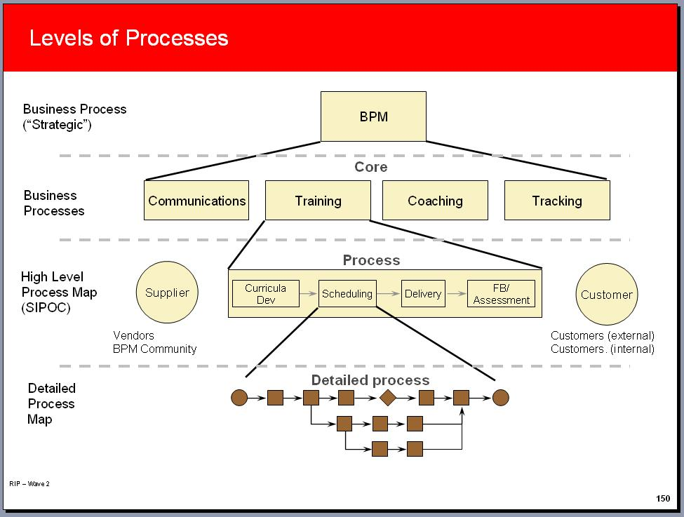
SIPOC/High level view
The focus for this project is at the end of the research process when different sources of data are delivered to the application development team in the Client Systems Group (CSG).
A detailed SIPOC mapping has been created. (Please refer to the attachment)
Suppliers: JDPA research team, respondents, vendors, and data processors
Inputs: Data files and presentation instructions uses to define the layouts and format of data, charts, and editorial content
Process: The technology process that publishes
data to the JDPA Compass web site application.
Output: Research data, charts, and content
via web based delivery platform
Customer: Researcher and executives
at the JDPA client companies

Slide 5
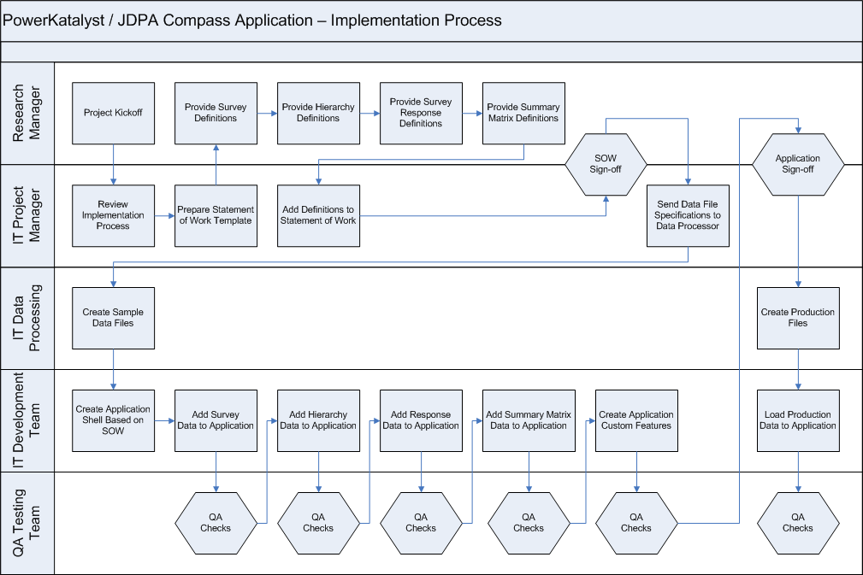
High Level Process Map

Slide 6
Major Areas for Improvement
1
2
3
4
5

Slide 7
Major Areas for Improvement
Creating the Project Statement of Work
    Each project can have a high degree of customization
    This requires a detail project requirements document or SOW
    This document is design to control scope and reduce variations between studies
    The project aims to eliminate the need for a detailed statement of work process
Adding Survey Questionnaire Information to Application
    Programmers currently needs to manually setup survey questionnaire data
    This step begins with the instructions provided by the research project team
    Programmers then map and format the survey questions
    This process may go through a number of cycles
Adding Hierarchy Data to Application to Application
    Programmers currently need to manually load the study hierarchy information
    Programmers map and format this data as well
    This process also goes through a number of cycles

Slide 8
Major Areas for Improvement
Adding Summary and Detail level to Application
    Programmers currently need to manually load the respondent level data
    and summary data such as index scores
    Programmers map and format this data as well
    This process also goes through a number of cycles
Numerous QA Testing Checks Through the Process
    There is a quality assurance test step for each of these manual processes
    The aims is to reduce the amount of testing before a study is delivered

Slide 9
Voice of the Customer
Critical To Satisfaction:
Technology Transformation Process
Quality
CTQ
Delivery
CTD
Cost
CTC
Accurate/ Error Free on Web Site
Timely Delivery of Data on Web Site
Low Cost Delivery on Web Site
Quality Assurance Reporting
Standard Loading Procedures
Automated Processes
Repeatability & Sustainable
Fewest Cycles to Error Fee Delivery
Reduced Dates
to Delivery
Reduced Time
to Update Data
Reduced Cost
to Deliver
Defect: > 3 Cycles
to Delivery Study
Defect: > 14 Days
to Delivery Study
Defect: > 1 Day to
Refresh Data
Defect: > $5,000 for Standard Delivery

Slide 10
Next Steps
Complete the Define and Measure stages
Define a set of quick wins for the project
Define a statement of work that focuses on the area for improvement

